Slide 1
Introduction to Hadoop

Slide 2
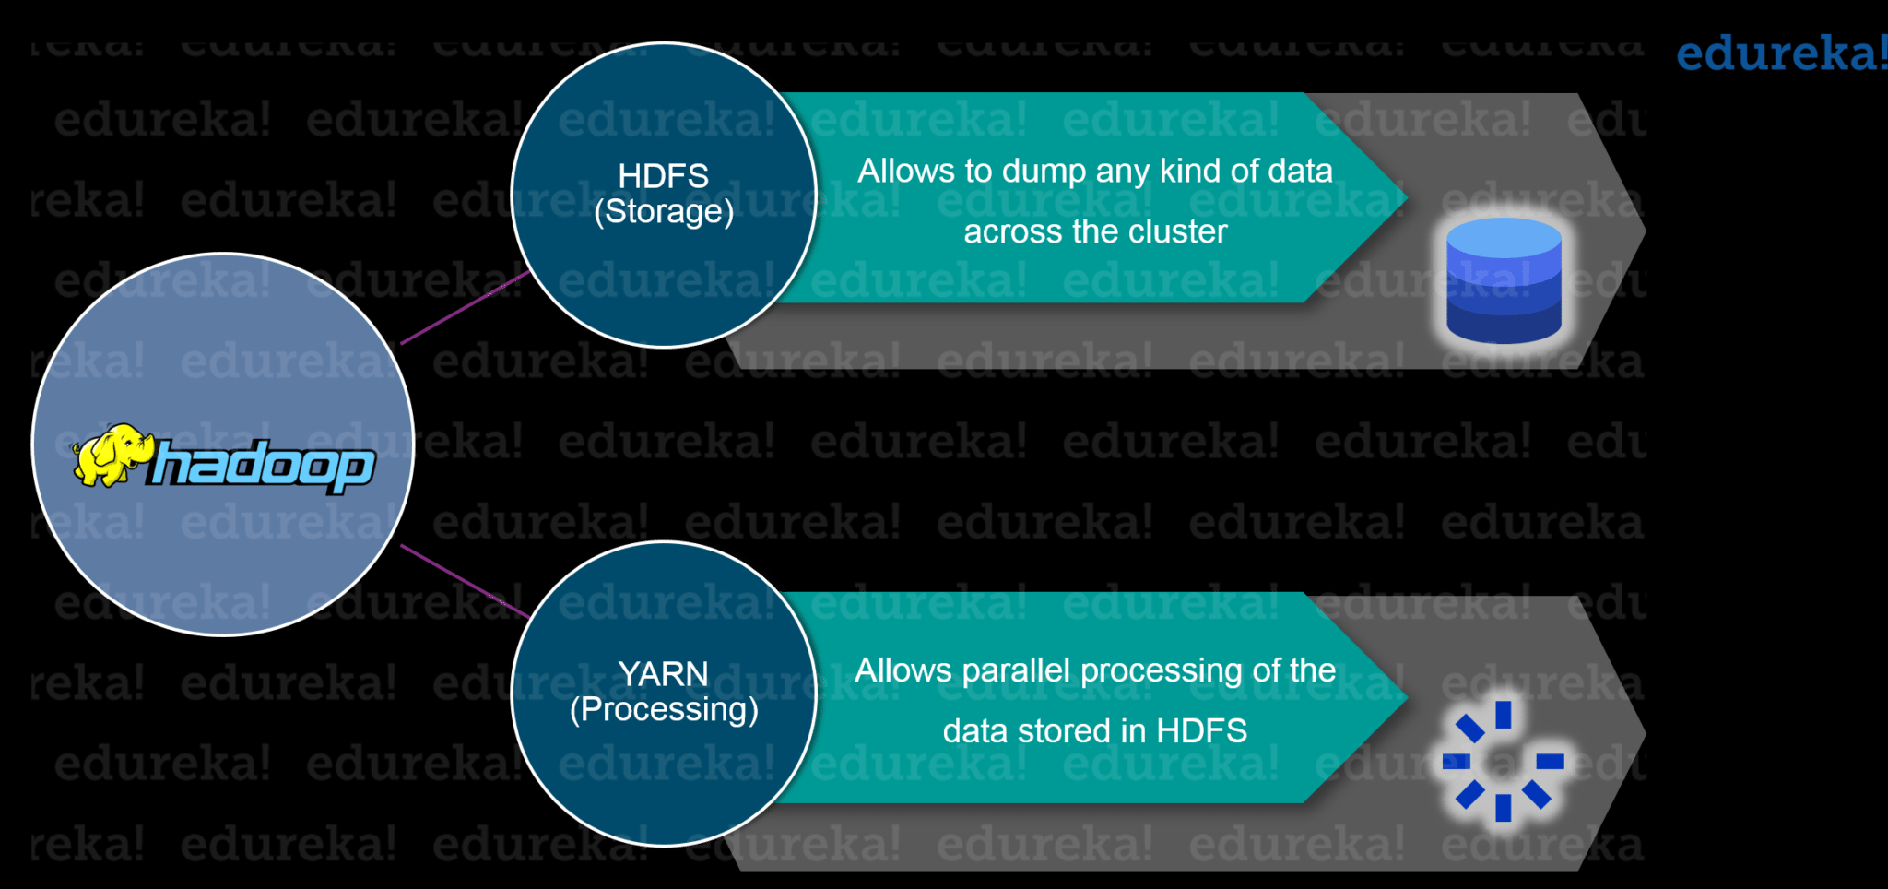
What is Hadoop
Hadoop is a framework that stores Big Data in a distributed environment, and enables processing Big Data in a parallel way.

Slide 3
HDFS
HDFS is a filesystem designed for storing very large files running on clusters of commodity hardware.
- Very large file: some hadoop clusters stores petabytes of data.
- Commodity hardware: Hadoop doesn’t require expensive, highly reliable harware to run on. It is designed to run on clusters of commodity hardware.

Slide 4
Blocks
- Files in HDFS are broken into block-sized chunks. Each chunk is stored in an independent unit.
- By default, the size of each block is 64 MB.

Slide 5
- Some benefits of splitting files into blocks.
-- a file can be larger than any single disk in the network.
-- Blocks fit well with replication for providing fault tolerance and availability. To insure against corrupted blocks and disk/machine failure, each block is replicated to a small number of physically separate machines.

Slide 6
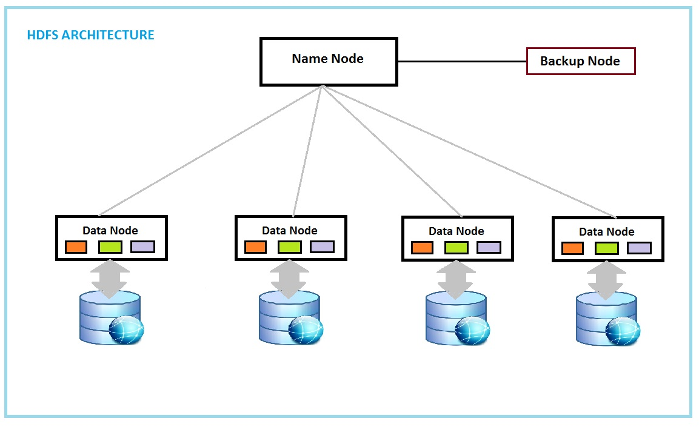

Slide 7
Namenodes and Datanodes
- The namenode manages the filesystem namespace.
-- It maintains the filesystem tree and the metadata for all the files and directories.
-- It also contains the information on the locations of blocks for a given file.
- datanodes: stores blocks of files. They report back to the namenodes periodically

Slide 8
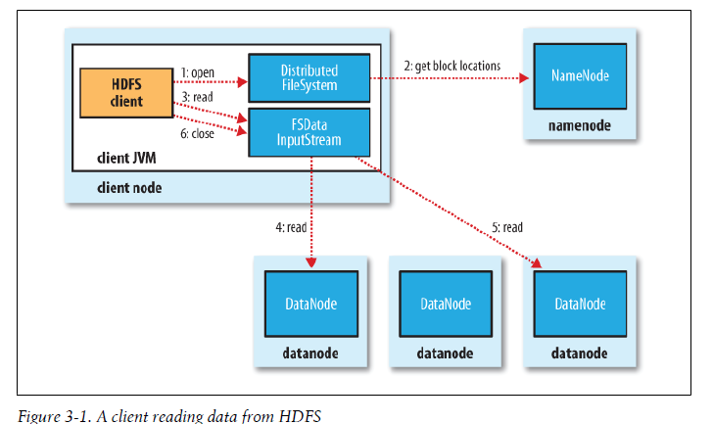

Slide 9
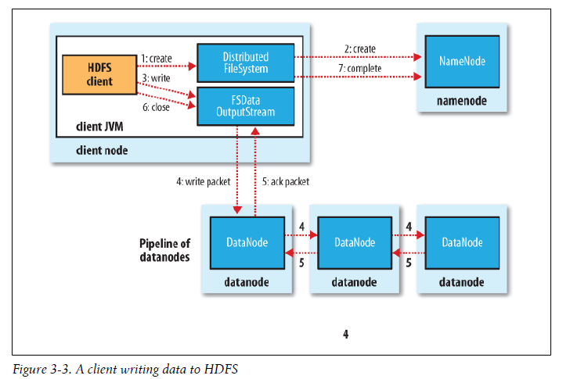

Slide 10
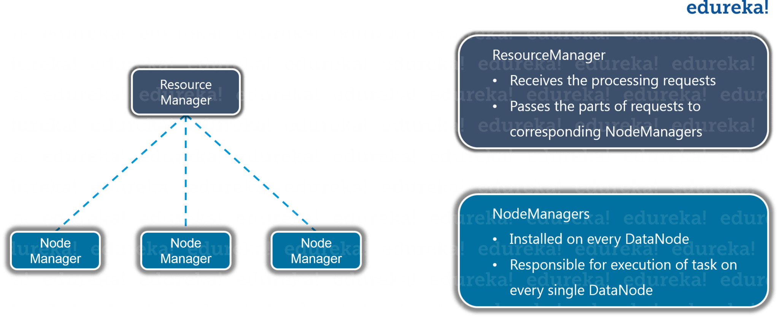
YARN
YARN (Yet Another Resource Negotiator) – A framework that performs parallel processing of data
https://www.edureka.co/blog/what-is-hadoop/

Slide 11
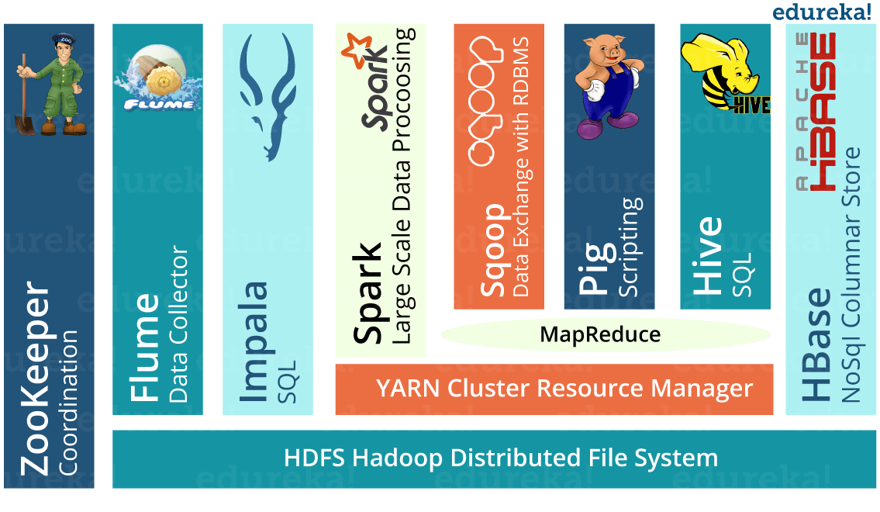
Hadoop Ecosystem
https://www.edureka.co/blog/what-is-hadoop/

